Slide 1
CNIT 25501 Final Presentation
Junsu Yoon - 0031408452
Doyun Won - 0033909003
Won Chan (Alex) Lee - 0034027556

Slide 2

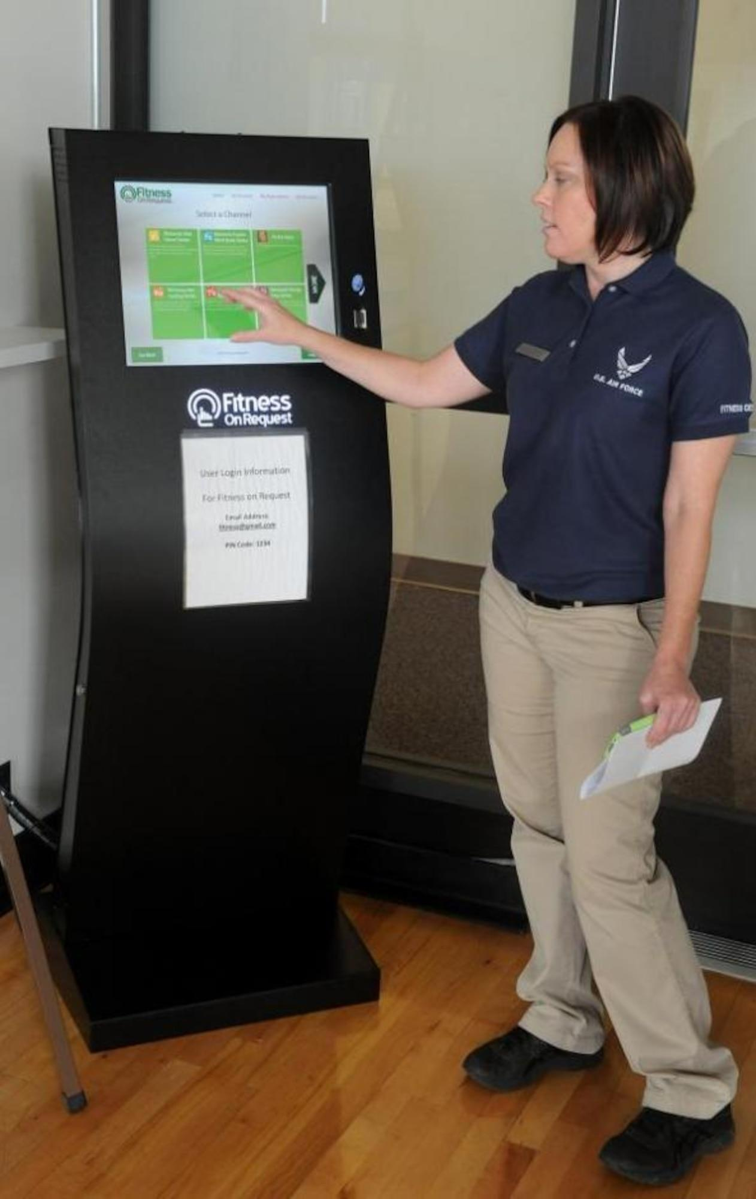
Purpose
Making a Kiosk program for cafe that sells bread and coffee
The Program will receive the amount of items customer is buying
The Program will request the card number
The card number has to be exactly 16 Numbers
The Program will calculate the items and make a receipt

Slide 3
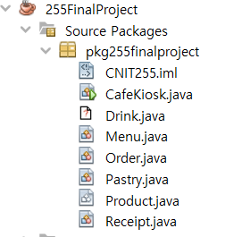
What Functions does it have?
6+ Different JAVA classes
CafeKiosk.java (Main Class)
Drink.java
Menu.java
Order.java
Pastry.java
Product.java
Receipt.java
2+ Inheritance relationships
Pastry inherit from Product
Drink inherit from Product
6+ association relationship between classes.
Menu-Product
Order-Product
CafeKiosk-Menu
CafeKiosk-Order
CafeKiosk - JOptionPane
Menu-HashMap
Works on GUI function

Slide 4

Demo

Slide 5
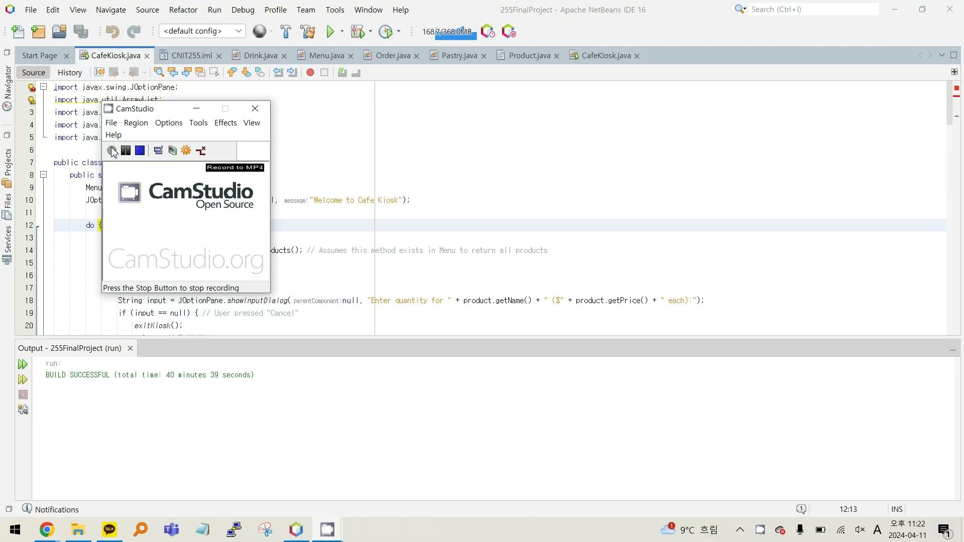
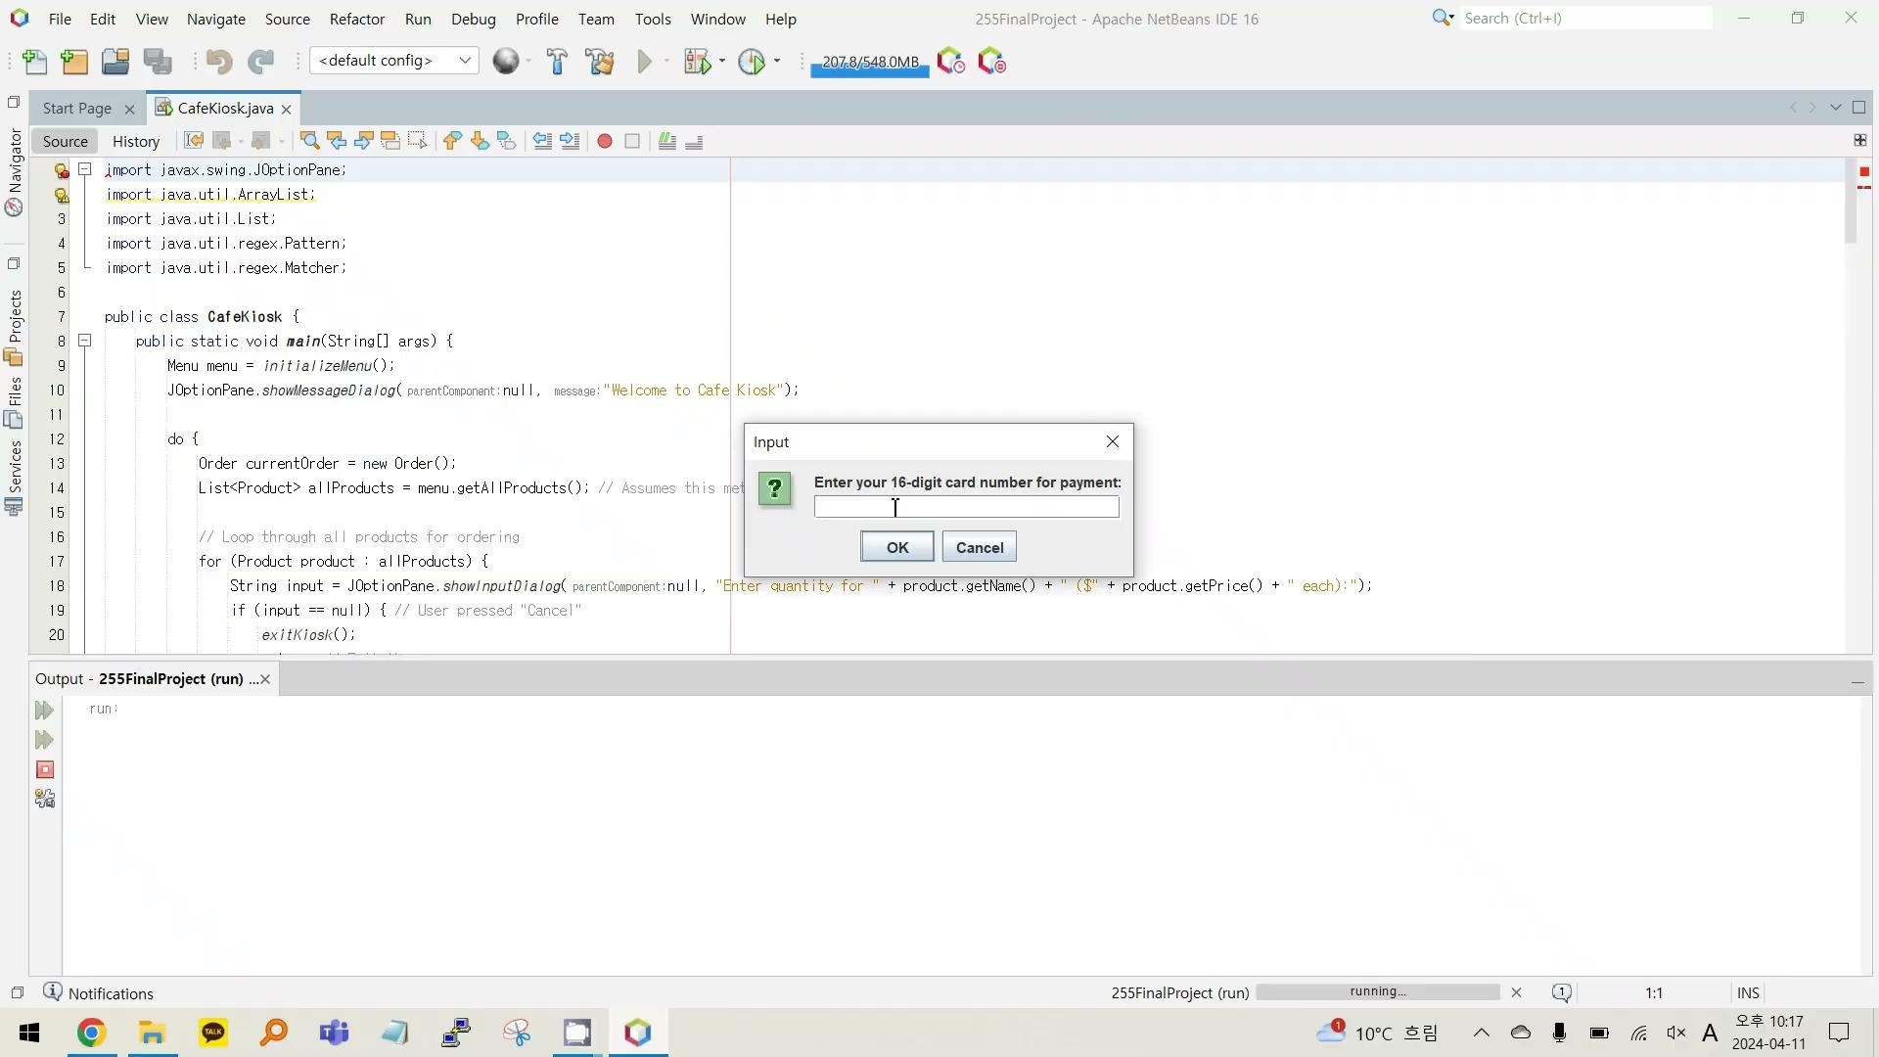
Unintentional Input(1)
wrong input for items
Unintentional Input(2)
wrong input for card number

Slide 6
Thank you

